Slide 1
Network Protocols (Pt 1) - TCP
By: Aidan Fetter

Slide 2
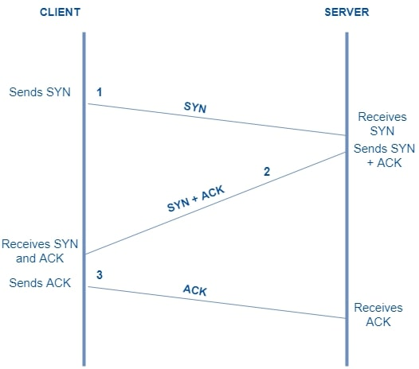
TCP
What is it?
Connection setup?
How does it send data?
Sequence Numbers?
Ending connectivity?
Examples?

Slide 3
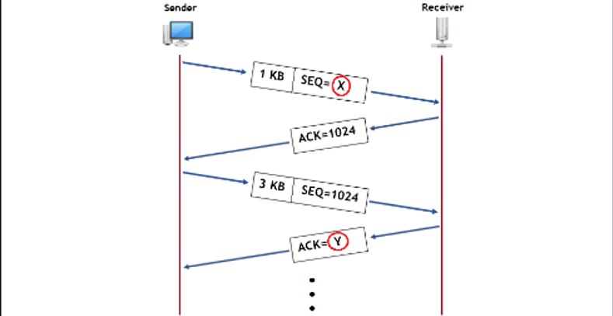
TCP
Ports?
Socket Address?
Netcat/Powercat
Wireshark Examination: Link
Report Time!

